Slide 1
Welcome to Marketing Management
Dr. Cecilia Ruvalcaba
BUSI 107 Week 11, Day 1

Slide 2
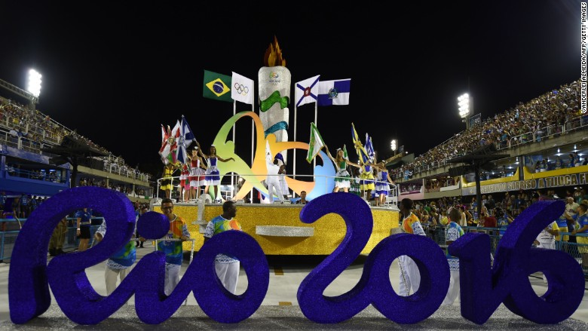

Notes:
Tickets to the 2016 Olympics aren't selling, and Brazil is scrambling to boost demand
http://money.cnn.com/2016/04/03/news/world/olympics-rio-ticket-sales/index.html

Slide 3
Delivering Value Through Marketing Channels Cont…

Slide 4
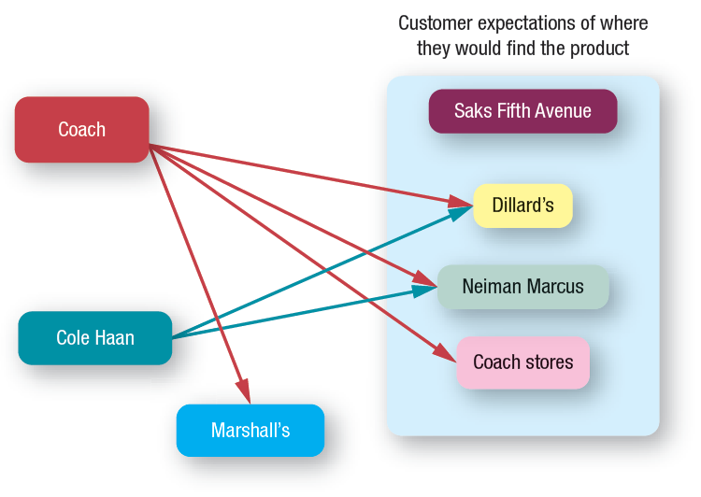
What Retailer?

Slide 5
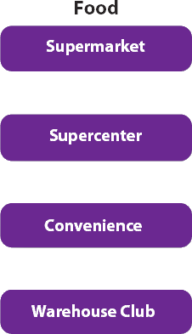
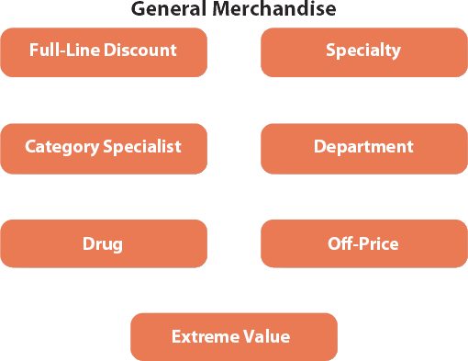
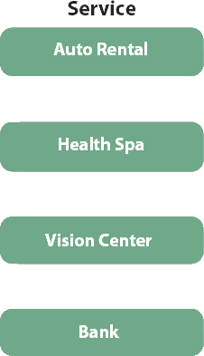
Choices, Choices….

Slide 6

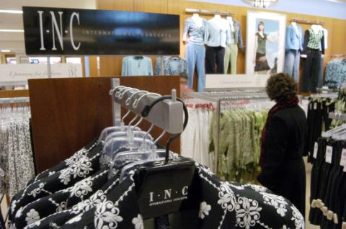
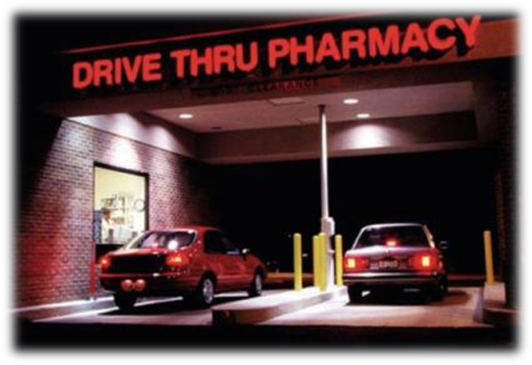
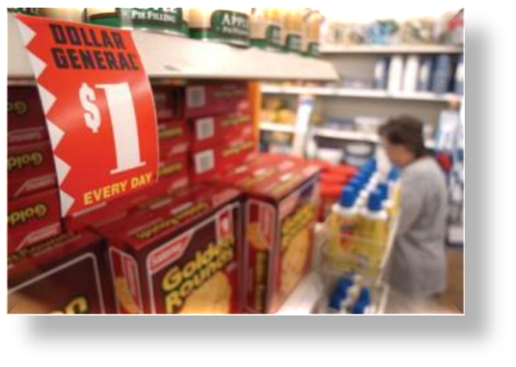
Using the 4P’s
Product
Price
Price defines the value of both the merchandise and the service provided
Providing the right mix of merchandise and services
Promotion
Place
Retailers use a wide variety of promotions, both within their retail environment and through mass media
Convenience is a key ingredient to success

Slide 7


Take Away for Today
Channel Selection is Key to Product Success!
Manage Relationships to create value!
The Value Conflict
Customer Demand vs. Channel Conflict

Slide 8

Next Class
Chapter 7: Business-to-Business Marketing
Chapter 8: Global Marketing

